Slide 1
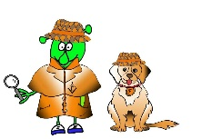
French Y4 Stage 2 Summer 2 – weather.
Language Detectives’ Memory Bank of weather.
Weather question and answers bank
Quel temps fait-il?- what’s the weather like?
Il fait du soleil – It’s sunny
Il fait du vent – It’s windy
Il fait du brouillard- It’s foggy
Il fait chaud – It’s hot
Il fait froid – it’s cold
Il neige – It’s snowy
Il pleut – It’s raining
Sound spelling
“emps”
”fait”
“ouill”
“aud”
Fascinating facts
Most consonants at the end of the word in French are silent letters.
Listen to the sound files and read along with the words and spot the silent letters.

